Slide 2
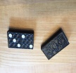
1.8 Domino
Objectives
The participants learn all about dominos as rectangle game pieces.
The participants learn to construct a domino on the paper.
The students learn to count from 0 to 9 and to visualize these numbers.
Tools, Materials and Organisation
Groups of 2 to 4 persons are sitting around a table.
On each table there is one set of dominos.
For the construction of a set of dominos from paper you need
a copy of this page and scissors to cut or
paper, ruler, pencil to construct and scissors to cut.

Slide 3
1.8 Domino
Description of the Lesson
First part of the lesson (15 minutes)
The participants construct their own set of 55 dominos.
During the construction they learn to count and to visualize the numbers from 0 to 9
Each participant has paper, ruler and pencil to construct and scissors to cut.
Second part of the lesson (30 minutes)
Make groups of 3 to 5 participants.
Play the domino game several times and note the winner.
Useful Hints
It is necessary, that each participant is constructing his own domino – this is learning by doing! Especially the visualizing of numbers is important.

Slide 4
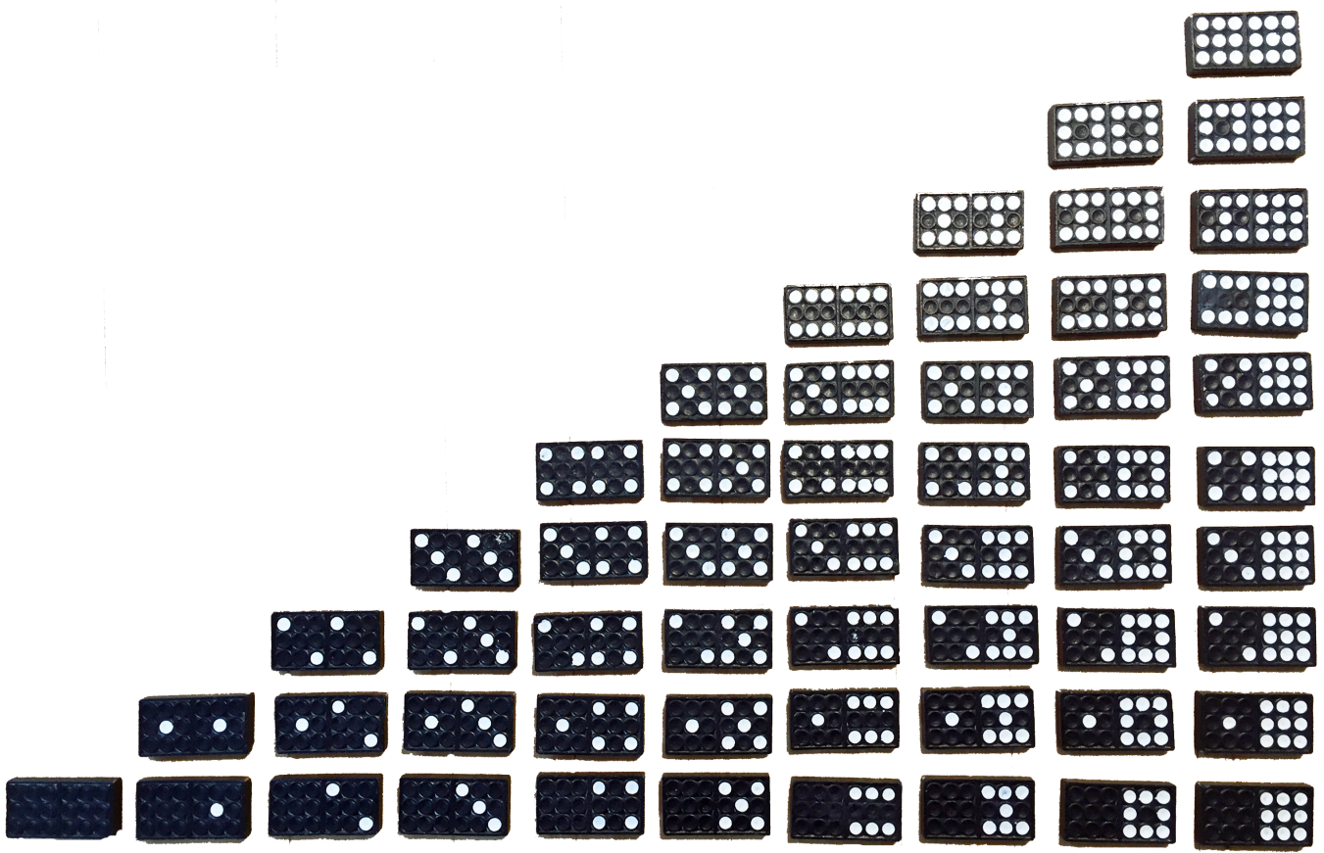
1.8 Domino

Slide 5
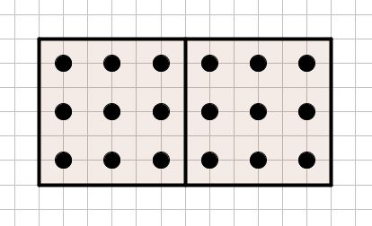
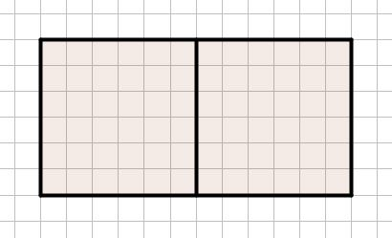
1.8 Domino
If you want to construct a full 55 domino set, you need to copy 7 of these templates.
It is important, that the participants can visualize the numbers from 0 to 9 by their own.
Please write the numbers below the stone!

Slide 6
1.8 Domino
If you want to construct a full 55 domino set, you need to copy 7 of these templates.
It is important, that the participants can visualize the numbers from 0 to 9 by their own.
Please write the numbers below the stone!

